Slide 1
Mechanical system
State space modelling

Slide 2
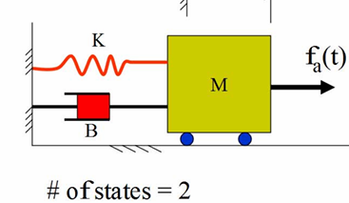

Slide 5

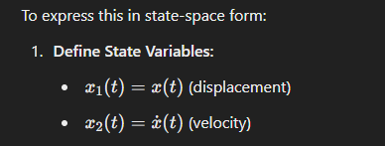
O/P, displacement, x (t)→ is the first state variable as x1
dx1/dt i.e. x1(dot) is the II state variable as x2

Slide 6
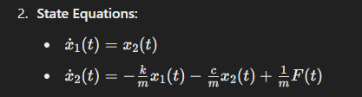
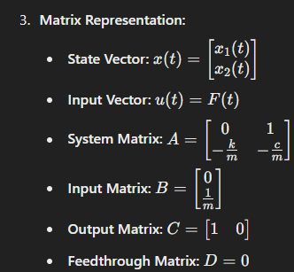
therefore

Slide 7
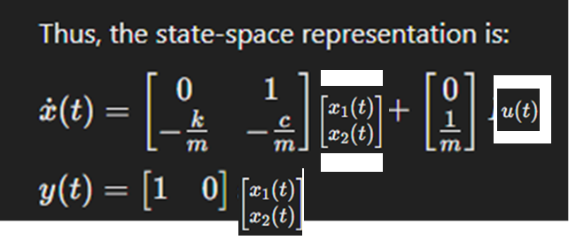

Slide 8
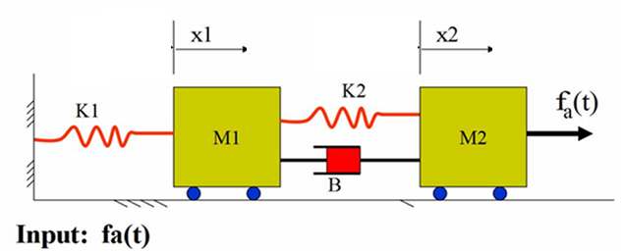


x₁ = x₁ & x₂ = x₂ are 2 state variables.
d x₁/dt = = x₃ as 3rd state variable and
d x₂/dt = = x₄ as 4th state variable

